Slide 1
Product Security Report for A WiFi Smart Plug
Notes:
Nunito
Font size 22

Slide 2

About the product
Turns electronics off or on from anywhere
Works directly with Amazon Alexa and Google Assistant
Schedule things in advance
Monitor energy usage
Notes:
The Beli SP3 is a smart Wi-Fi plug. It can turn electronics off or on from anywhere with your smartphone using the Beli app. You can schedule the Smart Plug to automatically switch off & on when you’re away or select a schedule for controlling many devices with the push of a button. The SP3 works directly with Amazon Alexa and Google Assistant to manage your devices through Voice Control.The Beli SP3 works on secure 2.4GHz wireless networks without the need for a separate hub.

Slide 3
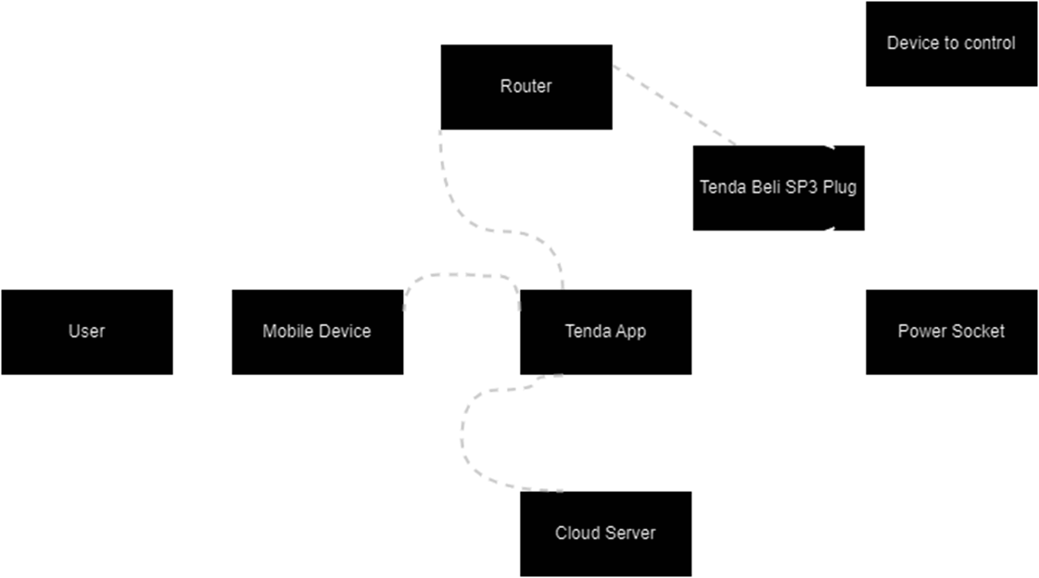
Data Flow Diagram

Slide 4
Requirements
Flash Memory
Microcontroller
Wifi module
RF transceiver
Electrical relay
User input push button
Smartphone app with wifi connectivity

Slide 5
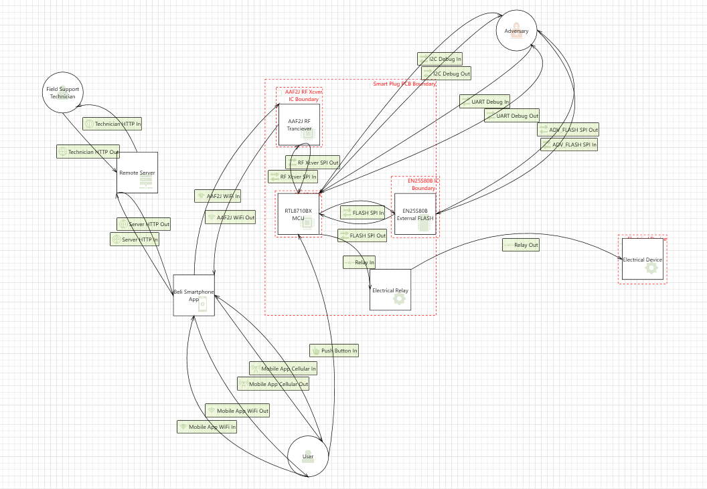
Threat Model DFD

Slide 6
Threat Modeling Report
Based on the Threat Modeling Data Flow Diagram
Total 149 threats were identified by the Microsoft Threat Modeling tool.
Shortlisted the most important 28 threats, and performed Vulnerability Assessment (Pre & Post Mitigation).

Slide 7
Testing & Research
Tools
  A computer
  USB to Serial Adapter
  Logic Analyzer
  Wireshark

Slide 8
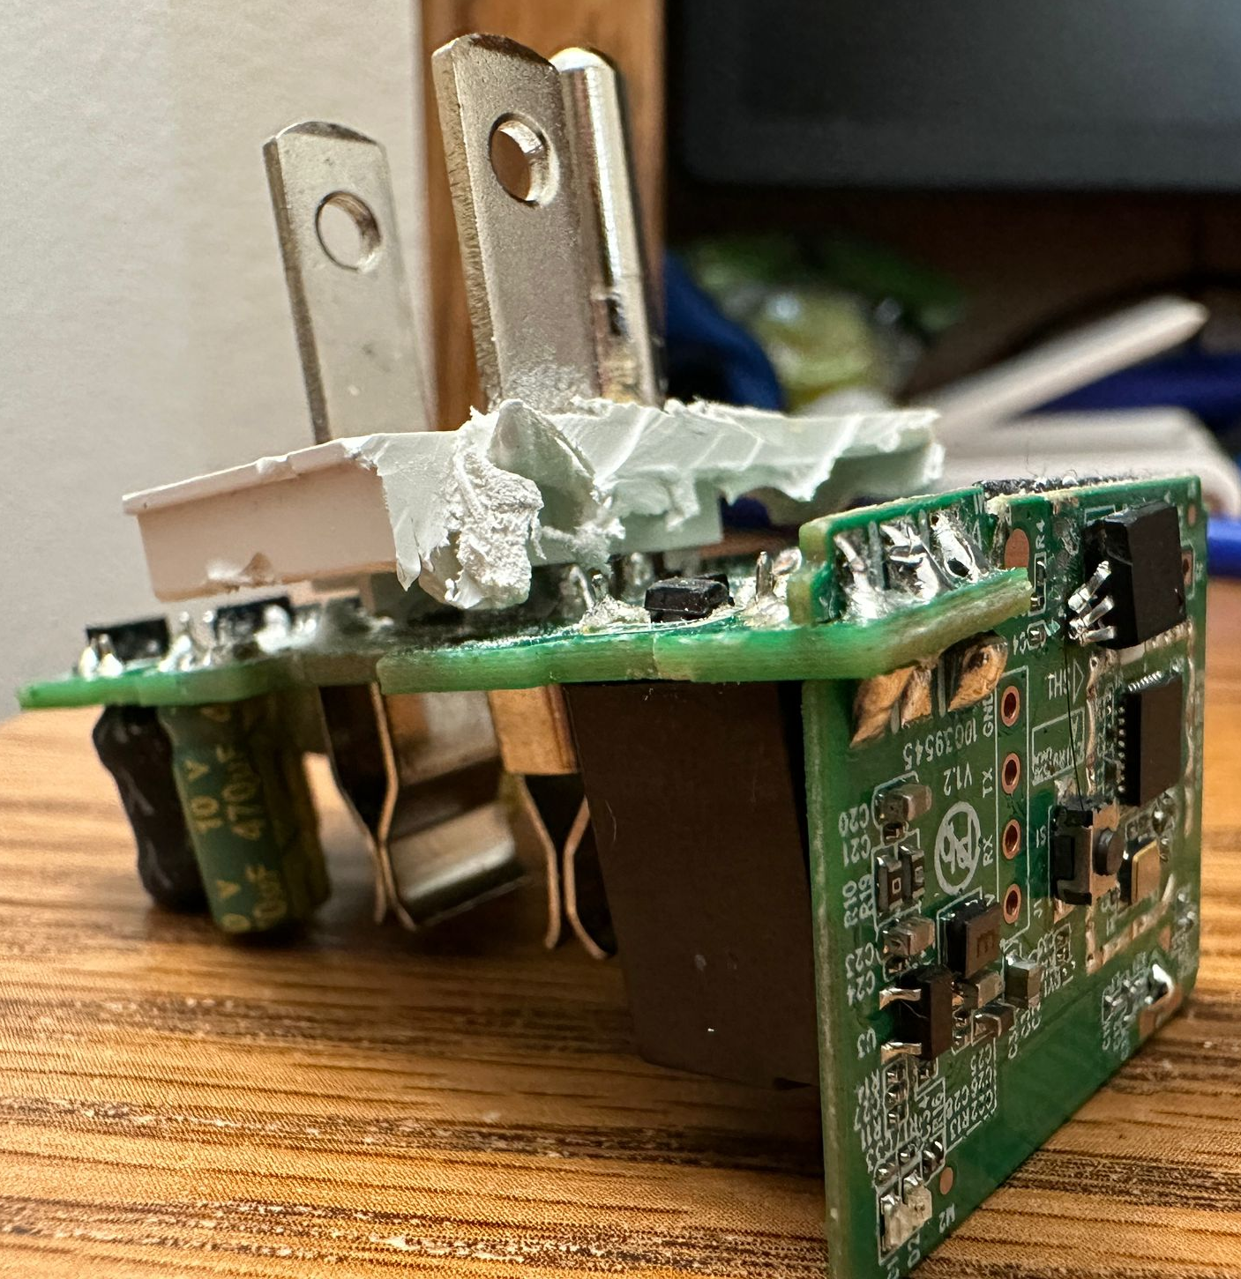
Testing & Research
Method
  Disassemble
  Trace UART communication using the Debug port (USB to Serial).
  Trace data packets over Wi-Fi using Wireshark.

Slide 9
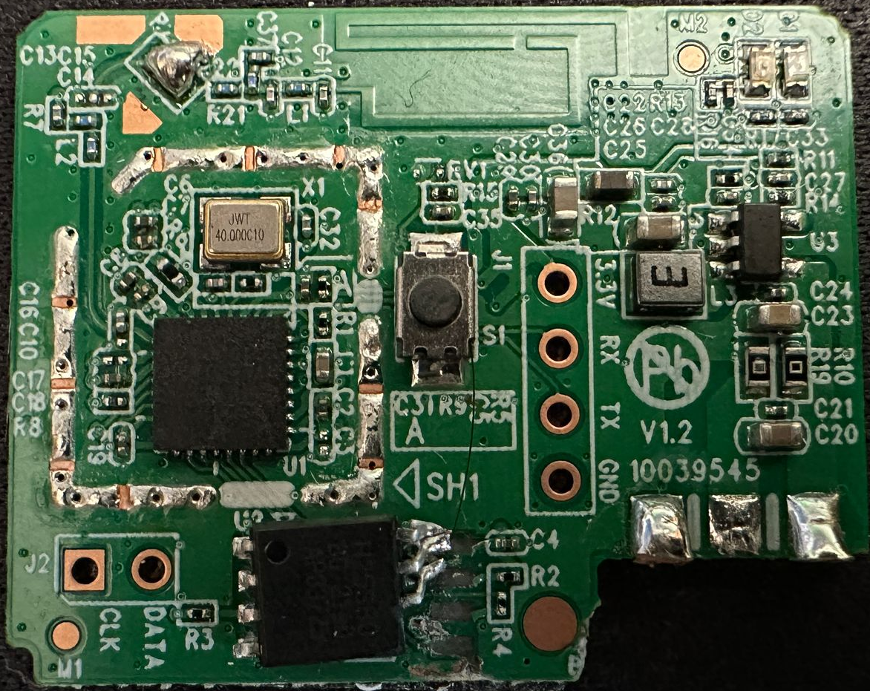
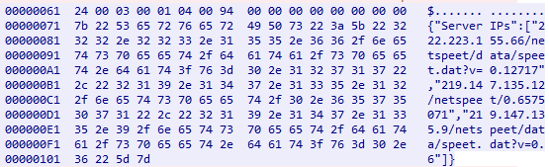
MCU with Wi-Fi
User input Push Button
RF Transceiver
Source: Link
FLASH Memory
UART Debug
I2C Debug

Slide 10
Testing & Research
Other possible testing methodologies
  Fuzz Testing: Sending malformed packets to the device to test response
  Penetration Testing: Simulate a cyber attack on the device to identify vulnerabilities
  Code Review: Review the source code to check for bugs or vulnerabilities.

Slide 11
Testing & Research
Findings
  SOAP over HTTP for communication
  Unencrypted Firmware
  Authentication Bypass
Disassembling & capturing data traffic exposes various vulnerabilities and provides a starting point for securing the device step by step.

Slide 12
Software Bill of Materials (SBOM)
List of all the third-party software components
Used by manufacturers
Helpful for end-users and consumers of the product
Included in product documentation
Notes:
"SBOM" stands for Software Bill of Materials. It is a list of all the third-party software components utilized in a product's software, including their versions, support status, and any known vulnerabilities. An SBOM is used by manufacturers to ensure they are aware of all the software components in their products and to monitor and manage any vulnerabilities or threats that may arise. It is also helpful for end-users and consumers of the product to be aware of the software components in use and any potential vulnerabilities or threats. The SBOM can be included in product documentation or made available in machine-readable formats for post-market surveillance.

Slide 13
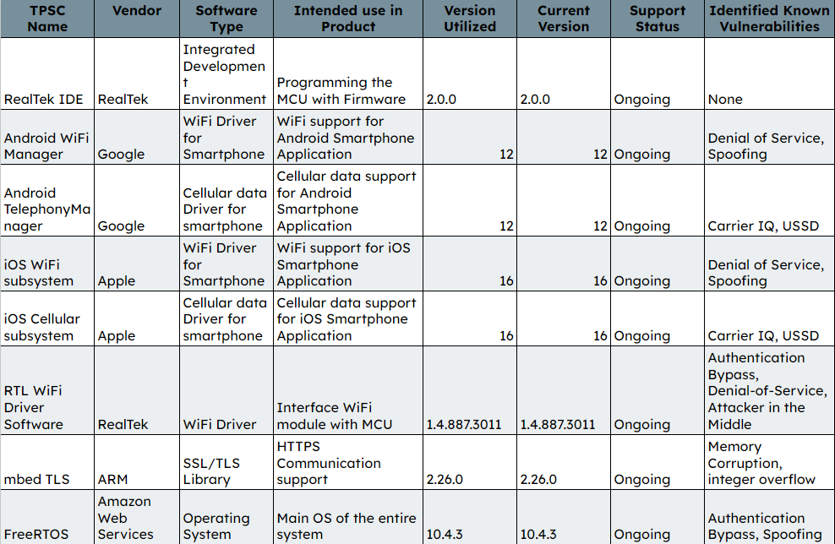
S B O M

Slide 14
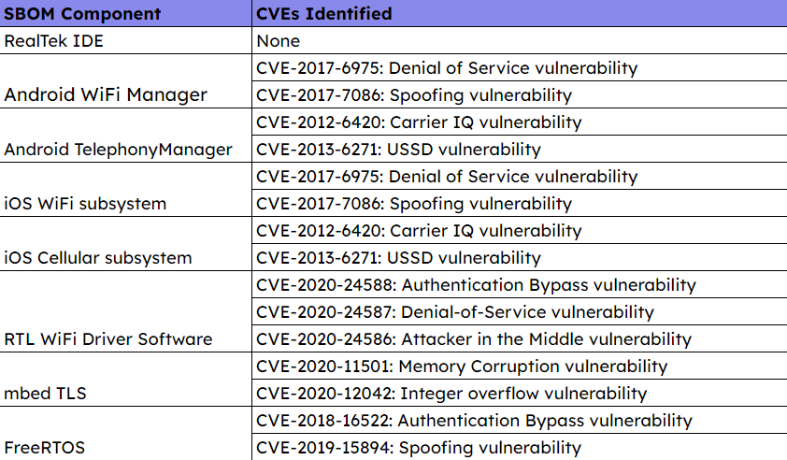
Third-Party Threat and Vulnerability Impact Analysis

Slide 15
Post-Market Surveillance - I
Establish a dedicated security team
Subscribe to security advisories
Regularly check vendor websites
Vulnerability databases
Automated vulnerability scanning
Notes:
As a manufacturer, it is crucial to actively monitor and identify known vulnerabilities affecting your system to ensure the security and reliability of your product. To perform post-market surveillance on the software components mentioned in the table above, you can take the following steps:
Establish a dedicated security team: Form a team responsible for tracking and monitoring vulnerabilities, assessing their impact on your product, and coordinating necessary updates or patches.
Subscribe to security advisories: Subscribe to security advisories and mailing lists provided by the vendors of the components you are using. This will help you stay informed about any known vulnerabilities, updates, or patches.
Regularly check vendor websites: Visit the websites of the vendors (RealTek, Google, Apple, ARM, Amazon Web Services) regularly to look for updates or security bulletins. These can provide valuable information about vulnerabilities and updates.
Vulnerability databases: Monitor vulnerability databases such as the Common Vulnerabilities and Exposures (CVE) and the National Vulnerability Database (NVD) for any vulnerabilities related to the software components in your product.
Automated vulnerability scanning: Implement automated vulnerability scanning tools to regularly scan your product's firmware and software for known vulnerabilities.
Periodic risk assessments: Conduct regular risk assessments to evaluate the potential impact of identified vulnerabilities on your product and prioritize the ones that need immediate attention.
Patch management: Develop a robust patch management process to ensure timely deployment of security updates and patches provided by the vendors.
Engage with the user community: Encourage users to report any security issues or vulnerabilities they discover in your product. Offer incentives like bug bounties to motivate users to help identify vulnerabilities.
Internal testing: Perform regular penetration testing and security audits of your product to identify potential vulnerabilities that might not have been reported yet.
Continuous improvement: Use the information gathered from the steps above to improve your product's security posture. This may involve updating components, modifying configurations, or even replacing certain components if necessary.

Slide 16
Post-Market Surveillance - II
Periodic risk assessments
Patch management
Engage with the user community
Internal testing
Continuous improvement
Notes:
Periodic risk assessments: Conduct regular risk assessments to evaluate the potential impact of identified vulnerabilities on your product and prioritize the ones that need immediate attention.
Patch management: Develop a robust patch management process to ensure timely deployment of security updates and patches provided by the vendors.
Engage with the user community: Encourage users to report any security issues or vulnerabilities they discover in your product. Offer incentives like bug bounties to motivate users to help identify vulnerabilities.
Internal testing: Perform regular penetration testing and security audits of your product to identify potential vulnerabilities that might not have been reported yet.
Continuous improvement: Use the information gathered from the steps above to improve your product's security posture. This may involve updating components, modifying configurations, or even replacing certain components if necessary.

Slide 17
Recommendations -
Developers and Manufacturers
Regular(Monitoring + Security Assessment + Patching)
Coordination with 3rd party vendors for timely updates
Secure coding practices and audits
Comprehensive security update & patch management
Security guidelines for end-users.
Notes:
Recommendations for Developers and Manufacturers of the Product
Regularly monitor and assess the latest security vulnerabilities and apply patches when available.
Coordinate with third-party component vendors to ensure timely updates and vulnerability fixes.
Implement secure coding practices and perform security audits to minimize implementation vulnerabilities.
Develop and maintain a comprehensive security update and patch management process for the product.
Provide clear and detailed security guidelines for end-users, including recommended configurations and best practices.

Slide 18
Recommendations -
End Users & Consumers
Regularly update
Manufacturer's guidelines & best practices
Strong passwords
Reduce attack surface by updation of other devices
Using a VPN
Notes:
Recommendations for End Users and Consumers of the Product
Regularly update the Tenda Beli SP3 Smart WiFi Plug firmware and associated apps to ensure the latest security patches are applied.
Follow the manufacturer's security guidelines and best practices for configuring and using the device.
Use strong and unique passwords for the device and associated accounts.
Keep other connected devices, such as smartphones and routers, updated to minimize potential attack vectors.
Be cautious when connecting to public WiFi networks and consider using a VPN to secure your connection.

Slide 19
Conclusion
Designed to remotely control electronic appliances
Incorporates several software components from various vendors
Remnants of residual vulnerabilities
A case of less security making the product more desirable
Notes:
The Tenda Beli SP3 Smart WiFi Plug is a device designed to remotely control electronic appliances via a WiFi connection. The device incorporates several software components from various vendors, including RealTek, Google, Apple, and Amazon Web Services. While the manufacturers have taken security measures to minimize vulnerabilities, some residual vulnerabilities remain
Oddly enough, this is a case of where less security might make the product more desirable for adaptation

Slide 20


